Slide 1
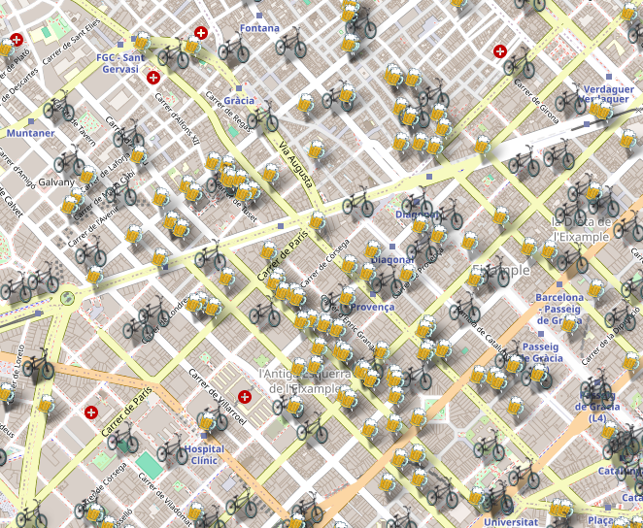
Barnabikes
Josu Arambarri Calvo
Rodrigo Alonzo Peña Vigil
Alberto González González
Sergio Martínez Lahoz

Slide 2

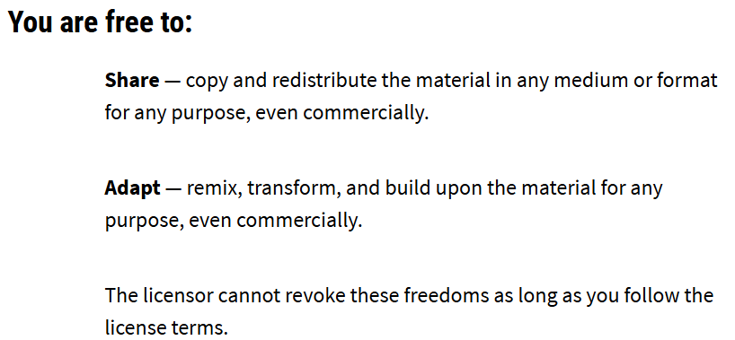
Datasets
BIKING STATIONS Licency: CC BY 4.0.
MUSIC AND BARS:
Licency: CC BY 4.0.
Both dataset include:
Latitude, Longitude
District, Neighborhood
https://opendata-ajuntament.barcelona.cat/data/es/dataset/culturailleure-espaismusicacopes
Notes:
https://frontend-29lp.onrender.com/

Slide 3
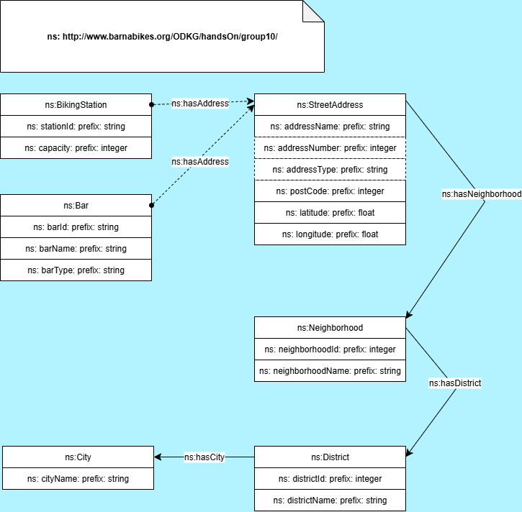
Ontology
Bar & BikingStation -->
-->StreetAddress -->
-->Neighborhood -->
--> District -->
-->City (Oscar’s Recommendation)
Chowlk Converter:
XML → Turtle (TTL)

Slide 4

Data Cleaning with OpenRefine
18
13
01
Simplify
Bicing: physical_configuration, last_updated, ttl, short_name, rental_uris.
Bars: timetable, estimated_dates, created, institution_name.
40
Removed "noise" columns
13
02
Structure
‘cross_street’ : ("01-CiutatVella / 02-El Gòtic",...
split into 4 columns: districtId, districtName, neighborhoodId, neighborhoodName.
‘address’, split into addressType, Name, and Number.
Split complex columns into new, atomic fields.
03
Standardize
E.g., 'C/', 'AV.', 'PL.' → 'CARRER', 'AVINGUDA', 'PLAÇA'.
Fixed typos and applied toTitlecase().
Unified inconsistent text values using "Mass Edit"
04
Structured Data
Created unique stationId (with MD5 hash).
Converted all IDs and coordinates to numbers (value.toNumber()).
Ensured data integrity and correct formats.

Slide 5
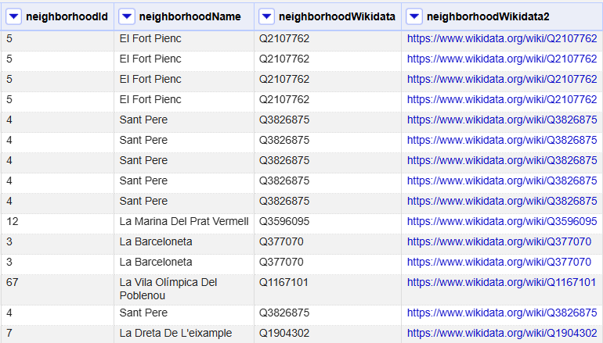
Linked data
Linked classes with Wikidata:
District
Neighborhood
City

Slide 6
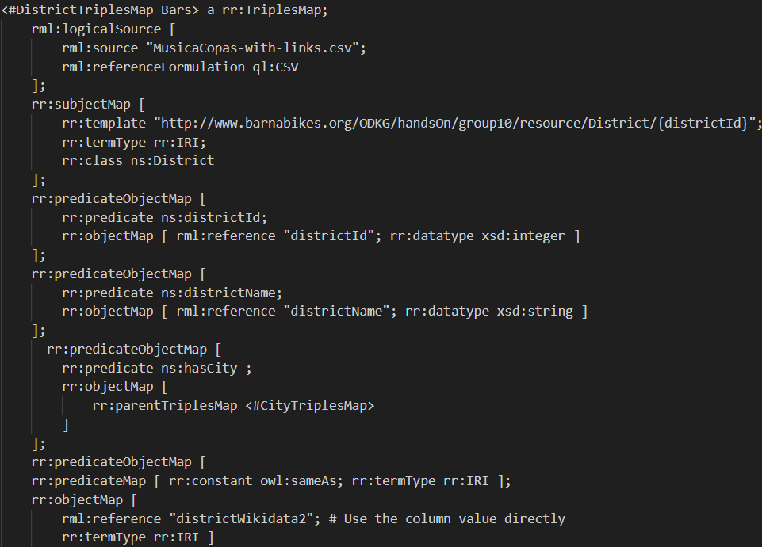

RML Mapping

Slide 7
RDF
<http://www.barnabikes.org/ODKG/handsOn/group10/resource/Bar/1033142110> a ns:Bar;
ns:barId "1033142110";
ns:barName "Cerveseria Antibiòtic";
ns:barType "Bars I Pubs Musicals";
ns:hasAddress <http://www.barnabikes.org/ODKG/handsOn/group10/resource/StreetAddress/41.38450_2.14627> .
<http://www.barnabikes.org/ODKG/handsOn/group10/resource/BikingStation/9fba2951> a
ns:BikingStation;
ns:capacity 24;
ns:hasAddress <http://www.barnabikes.org/ODKG/handsOn/group10/resource/StreetAddress/station_9fba2951>;
ns:stationId "9fba2951" .

Slide 8

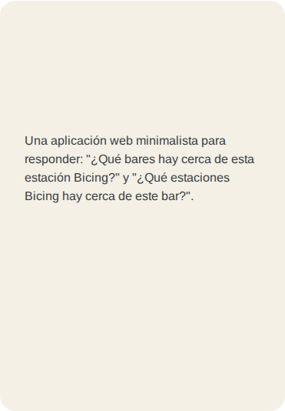
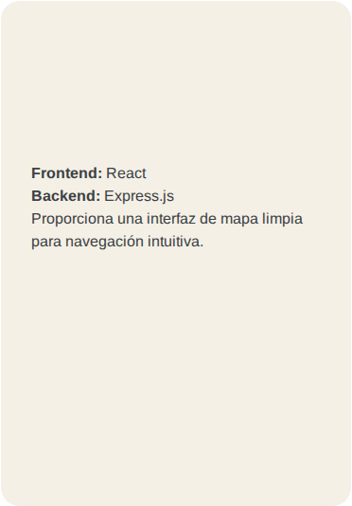
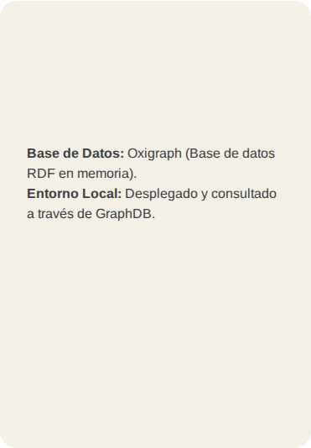








Demo
https://frontend-29lp.onrender.com/
Concept
Technical stack
Database
Given a bike station, find and display the 3 closest bars to that station.
Given a bar, find and display the 3 closest bike stations to that bar.
FRONTEND:
BACKEND:

